Slide 1

2016-2017
Steel Bridge Team
April 28, 2017
Sabrina Ballard
Sean Hopper
Ryan Morofsky
Meg Stevens
CENE 486C

Slide 2

Project Description
Project Purpose
  American Institute of Steel Construction (AISC) and American Society of Civil Engineers (ASCE) Student Steel Bridge Competition
  1:10 scale model steel bridge
Technical Considerations
  50 pounds lateral load
  2500 pounds vertical load
Potential Challenges
  Member sizes under 36”x4”x6”
  Minimizing deflection and weight
Figure 1. Official Rules [1]
2 Morofsky

Slide 3


Project Understanding
Client
Technical Advisor
Mark Lamer, PE
Thomas Nelson, MS, PE, SE
Stakeholders
  Future owners of homes in Beaver Lodge Estates
  Northern Arizona University (NAU) ASCE Student Chapter
3 Morofsky

Slide 4
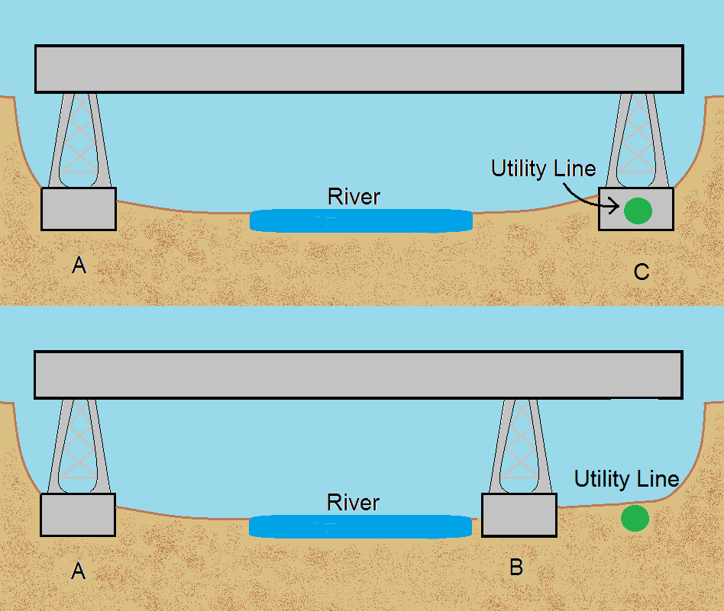
Identification of Alternatives
Footings
  AB vs AC
Bridge Types
  Top chord vs beam bridge
Connections
  Gusset plate vs slip connection
Figure 2. Footing Options
4 Morofsky

Slide 5
Identification of Selected Designs
Bridge Members
Table 1: Bridge Member Decision Matrix
 |  | 4x6 HSS Tubing | 2D Mini-Truss | Triangular 3D Mini-Truss | Square 3D Mini-Truss | Rectangular 3D Mini-Truss
 | Weight % | Weighted Score | Weighted Score | Weighted Score | Weighted Score | Weighted Score
Deflection | 75% | 0.75 | 1.5 | 3 | 2.25 | 3.75
Weight | 25% | 1.25 | 1 | 0.75 | 0.5 | 0.25
Total | 100% | 2 | 2.5 | 3.75 | 2.75 | 4
5 Morofsky

Slide 6
Identification of Selected Designs
Defection Reduction
Table 2: Deflection Reduction Decision Matrix
 |  | Increase Moment of Inertia | Increase Member Size | Increase Member Thickness
 | Weight % | Weighted Score | Weighted Score | Weighted Score
Deflection | 50% | 4.5 | 1.5 | 4.5
Weight | 50% | 4.5 | 0.5 | 0.5
Total | 100% | 9 | 2 | 5
6 Morofsky

Slide 7
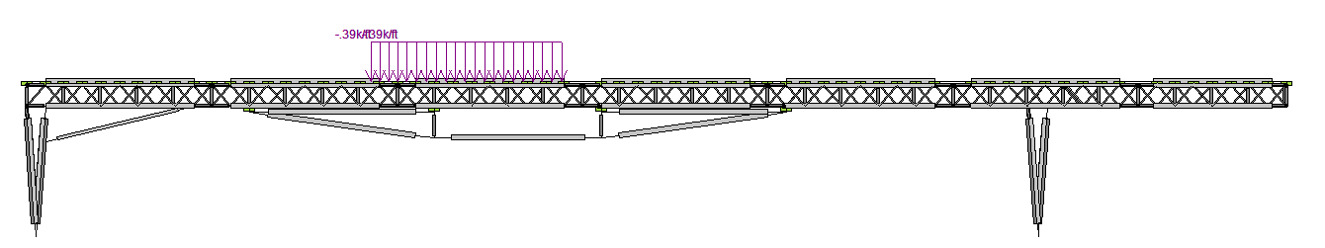
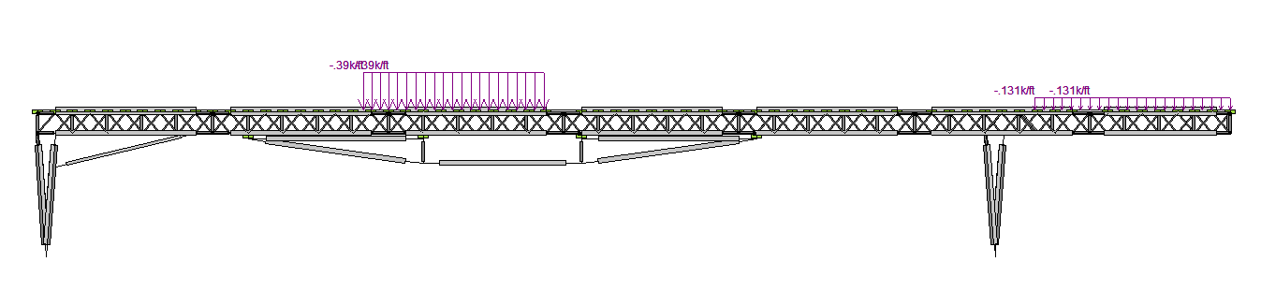
Design Analysis - RISA Model
-390 lb/ft
Figure 3. RISA Load Combination 1-1
-390 lb/ft
-130 lb/ft
Figure 4. RISA Load Combination 1-2
7 Ballard

Slide 8
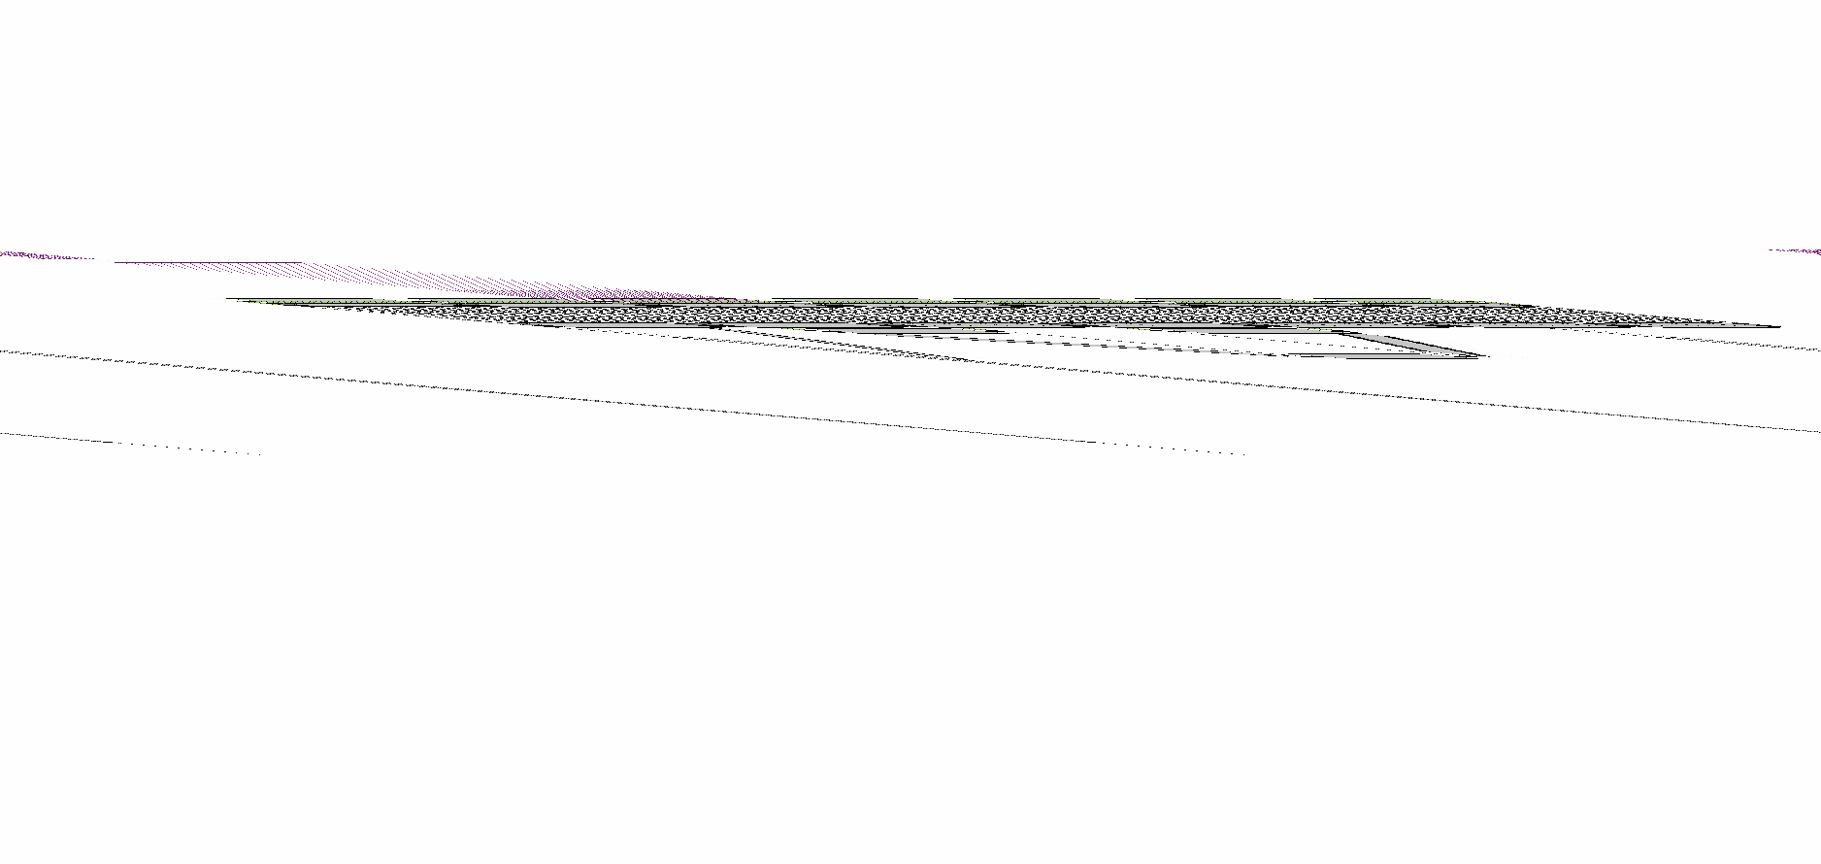
Load Case 1-1 Deflection
8 Ballard

Slide 9
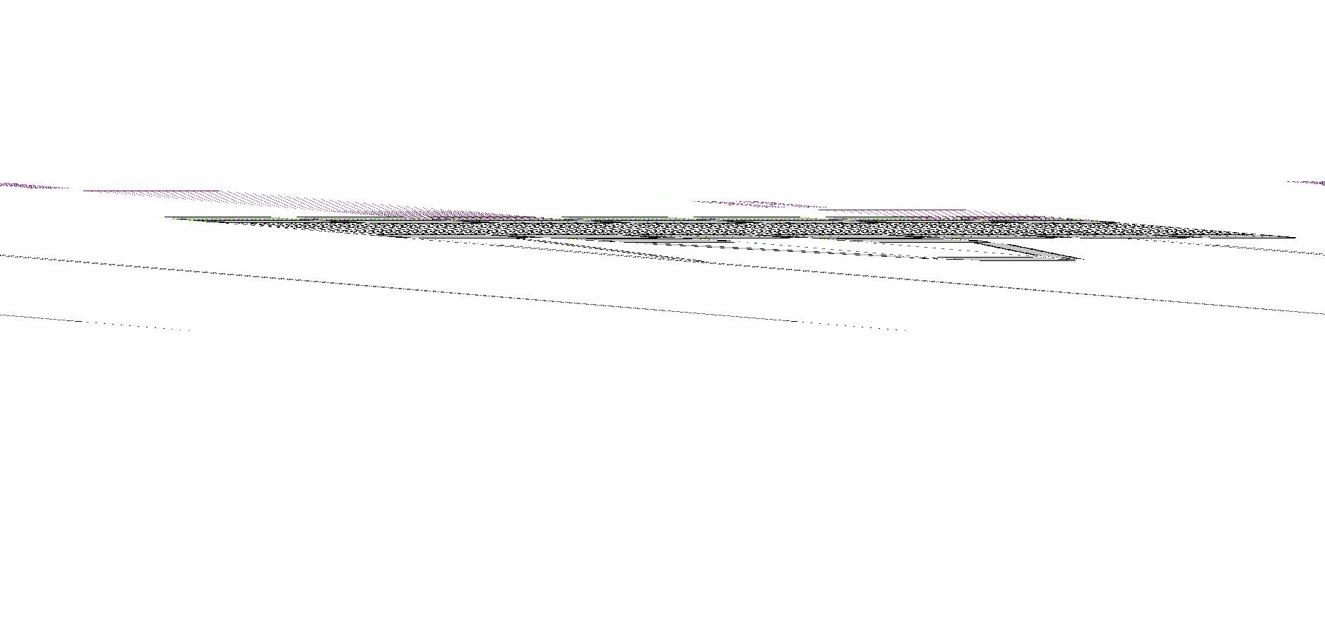
Load Case 1-2 Deflection
9 Ballard

Slide 10
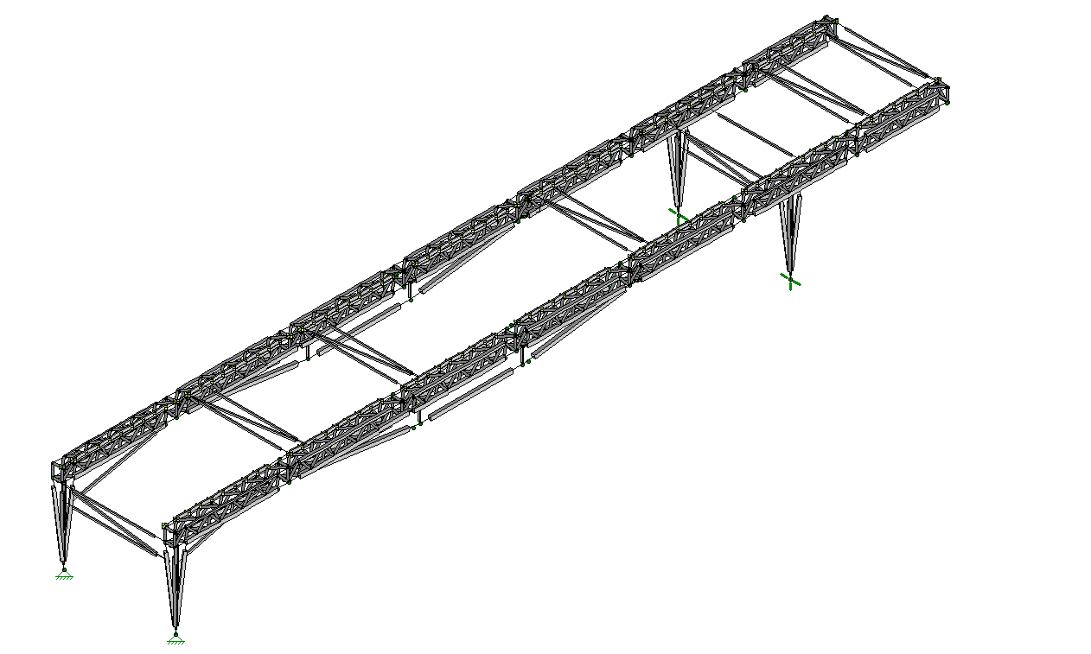
Final Design
Mini Truss
1/4” rod
1”x1”x1/16” HSS bottom chord
3/4”x3/4”x1/16” HSS or 1/2”x1/2”x1/16” HSS top chord
1”x1/2”x1/16” HSS decking
Lateral Bracing
1/2”x1/2”x1/16” HSS.
Foundation Legs
3/4”x 3/4”x1/16” HSS
Substructure
1” x 1” x 1/16” HSS
3/4”x 3/4”x1/16” HSS
Lateral Bracing
Mini-truss
Substructure
Foundation Legs
Figure 5. Final RISA Design
10 Ballard

Slide 11
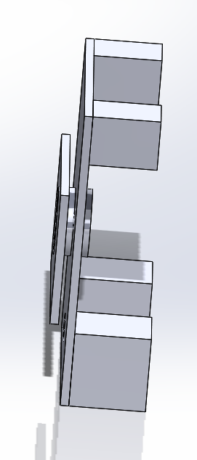
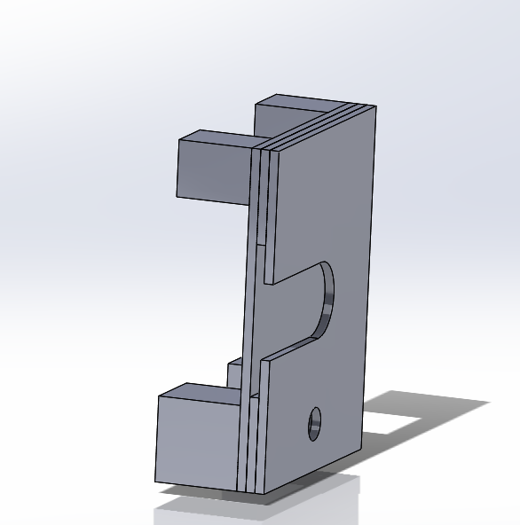
Connection Design
Minimum Edge Distance
Bolt Shear Strength
Bolt Tensile Strength
Block Shear
Bearing Capacity
Tensile Yielding
Plate Bending Capacity
Figure 6. Female Connection
Figure 7. Male Connection
11 Ballard

Slide 12
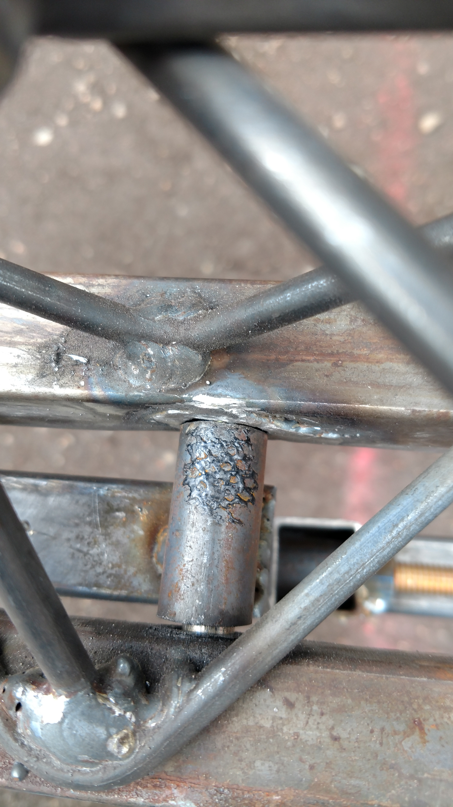
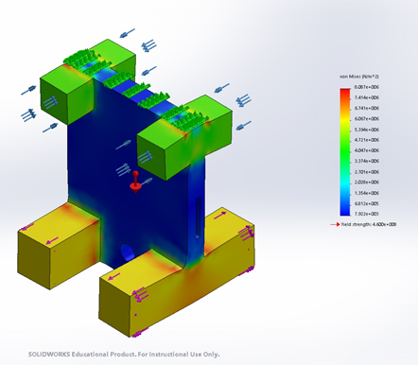
Connection Design
\
Figure 8. Solid Works Model
Figure 9. Substructure Connection
12 Hopper

Slide 13
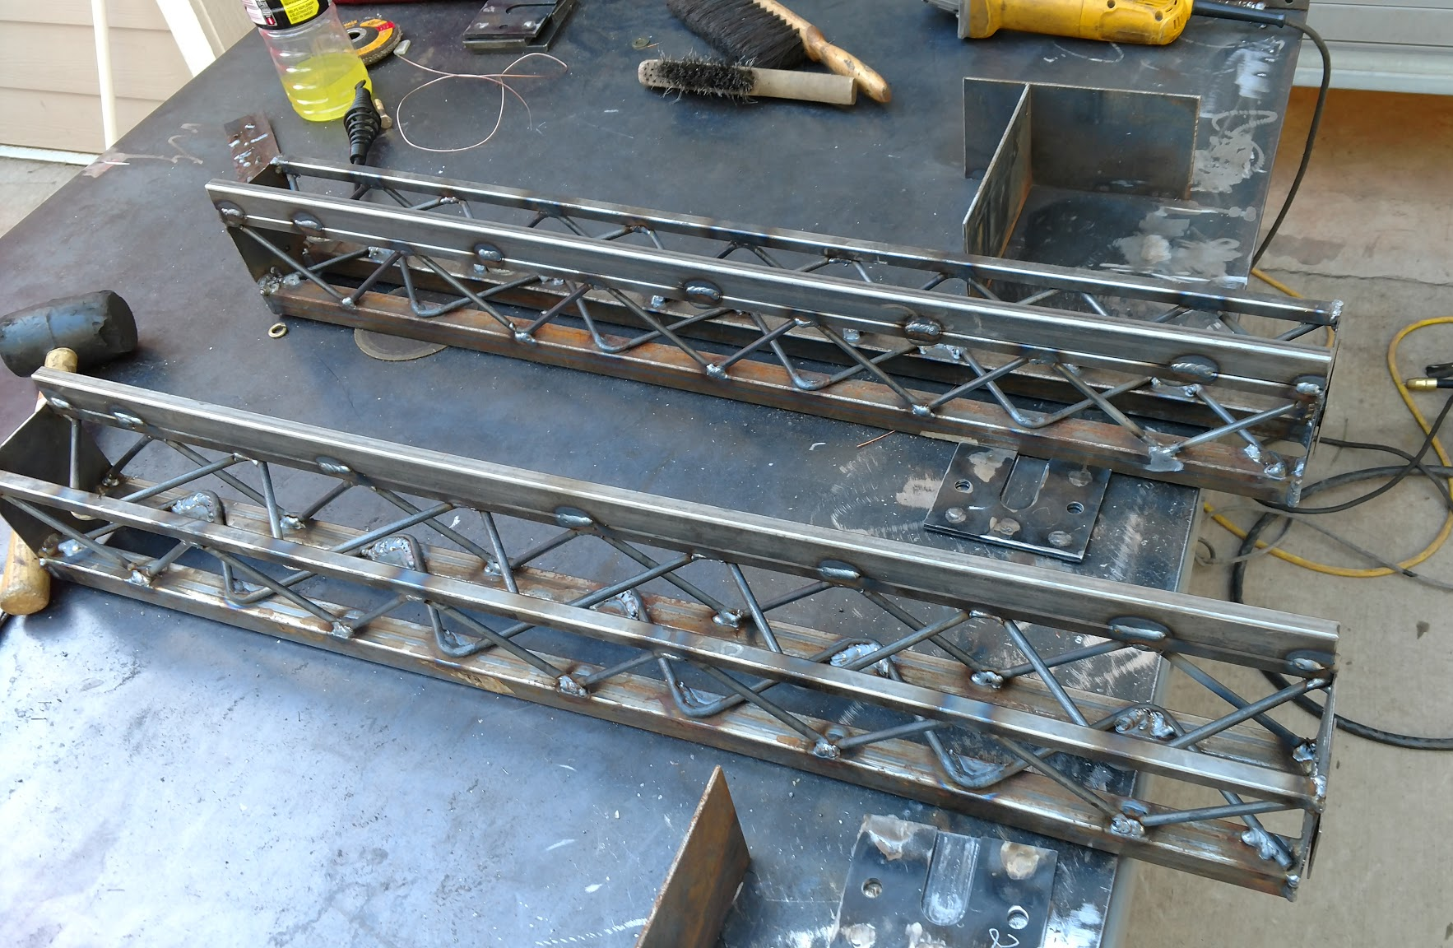
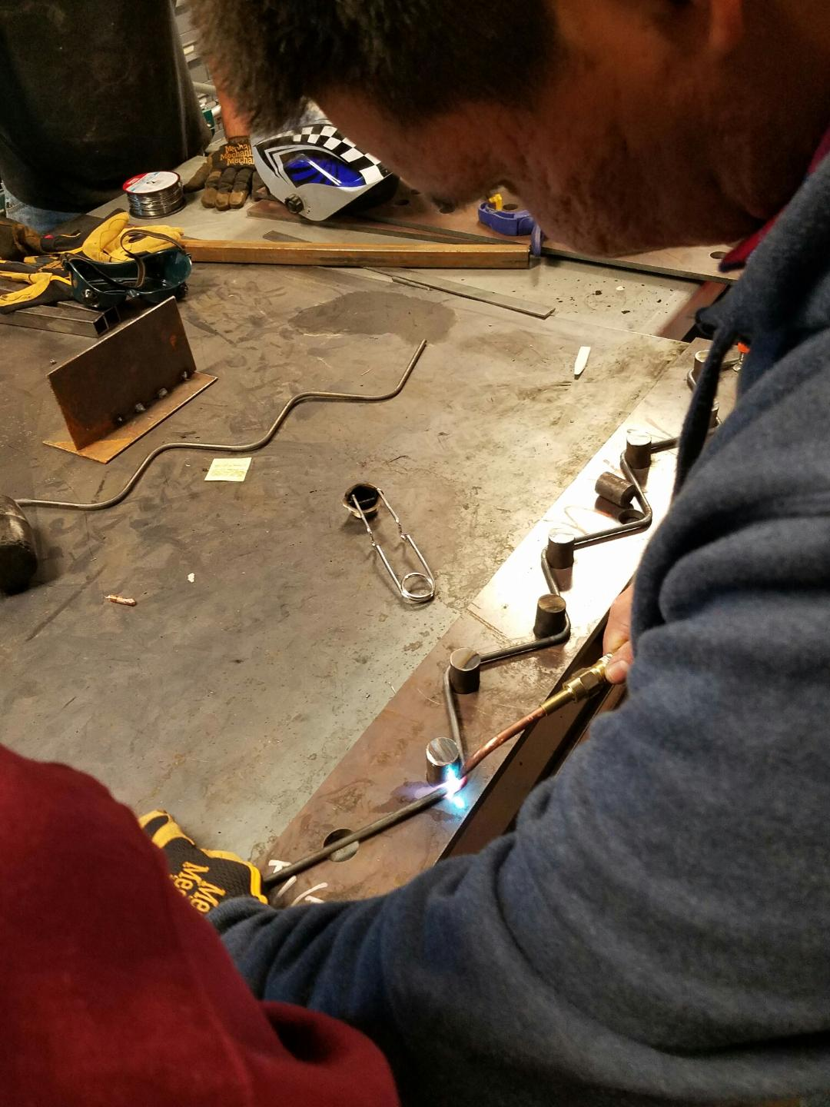
Fabrication
Measured, cut, welded, grinded
Bent rod instead of cut
Welded on the nuts
Sandblasted and spray painted
Figure 11. Completed Mini-Truss
Figure 10. Bending Rod in Jig
13 Hopper

Slide 14
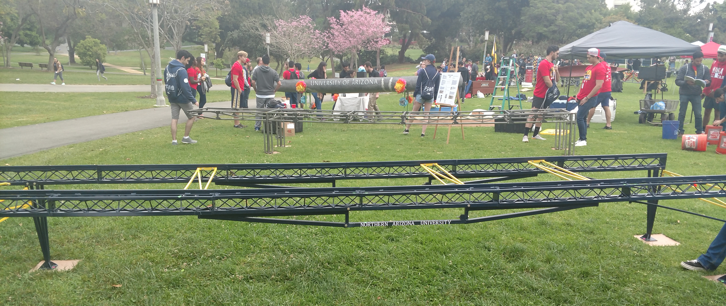
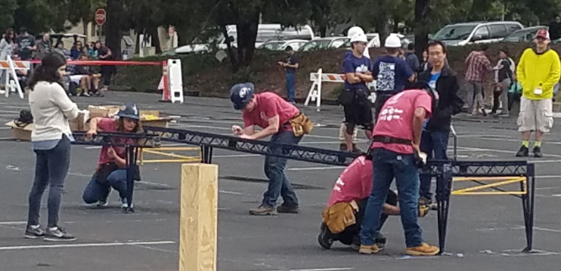
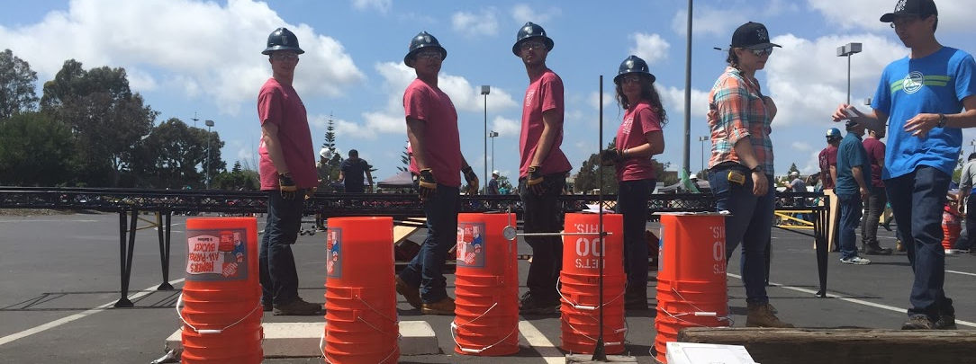
Pacific Southwest Conference
Figure 12. Display Day
Figure 13. Timed Construction
Figure 14. Vertical and Lateral Load Test
14 Hopper

Slide 15
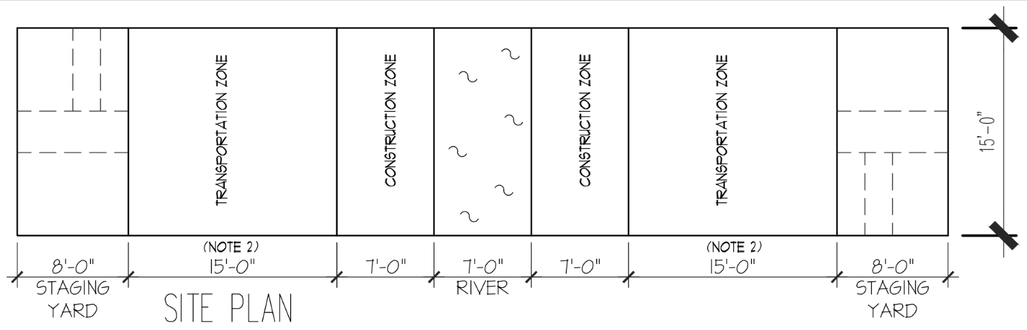
Pacific Southwest Conference
Figure 15. Timed Construction Layout [1]
15 Hopper

Slide 16
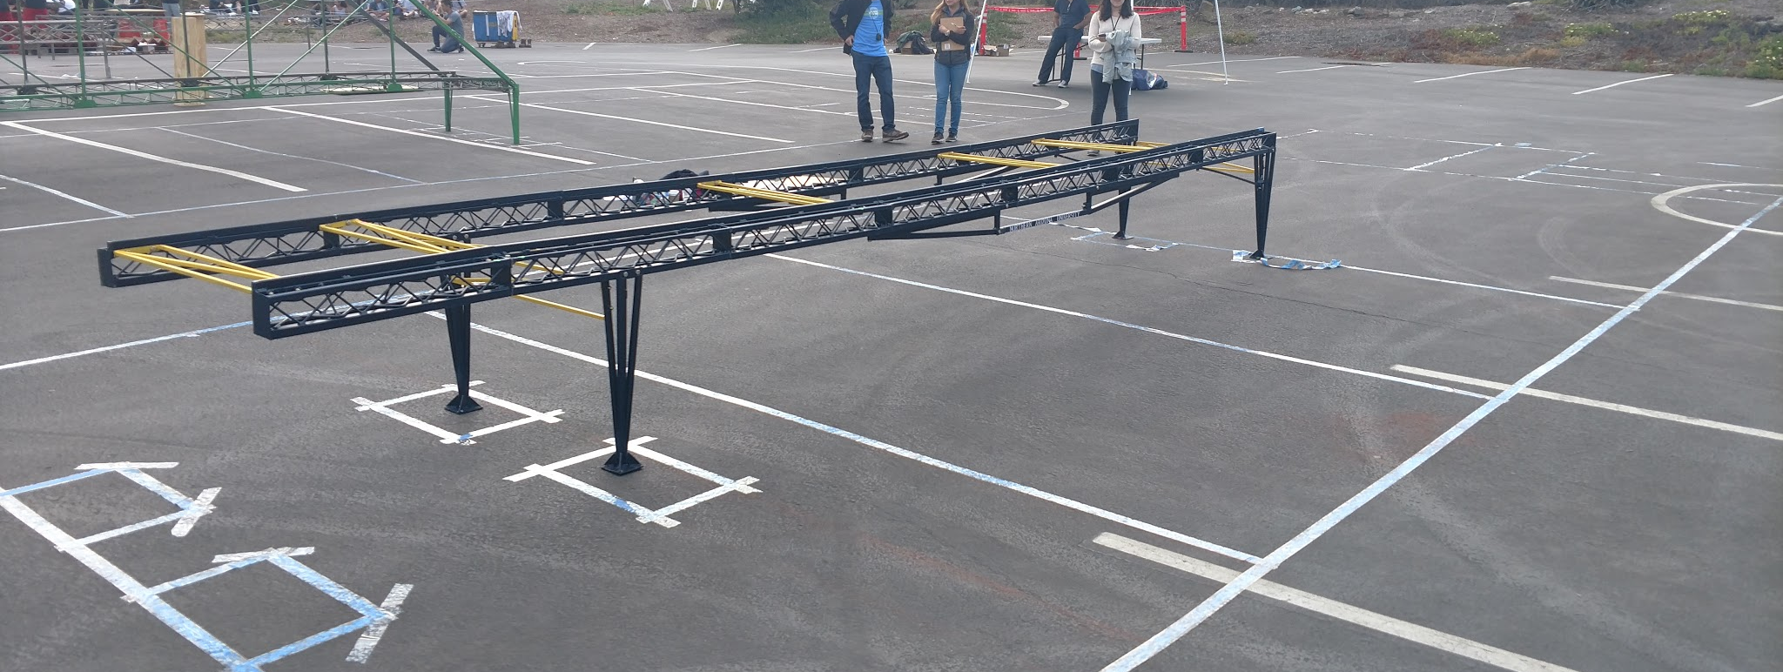
Pacific Southwest Conference
Figure 16. Completed Bridge After Construction
16 Hopper

Slide 17
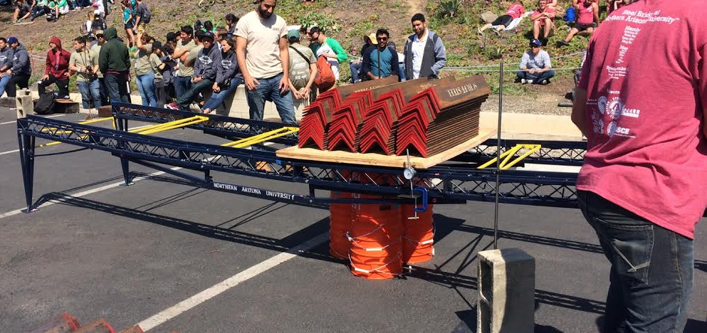
Deflection Results
Figure 17. Bridge at Full Mid-Span Loading
Table 3. Deflections
 | Allowable Deflection (in) | Anticipated Deflection (in) | Actual Deflection (in)
Vertical | 3 | 0.645 | 2.3
Sway | 1 | 0.669 | PASS
Lateral | 0.5 | 0.252 | PASS
17 Stevens

Slide 18
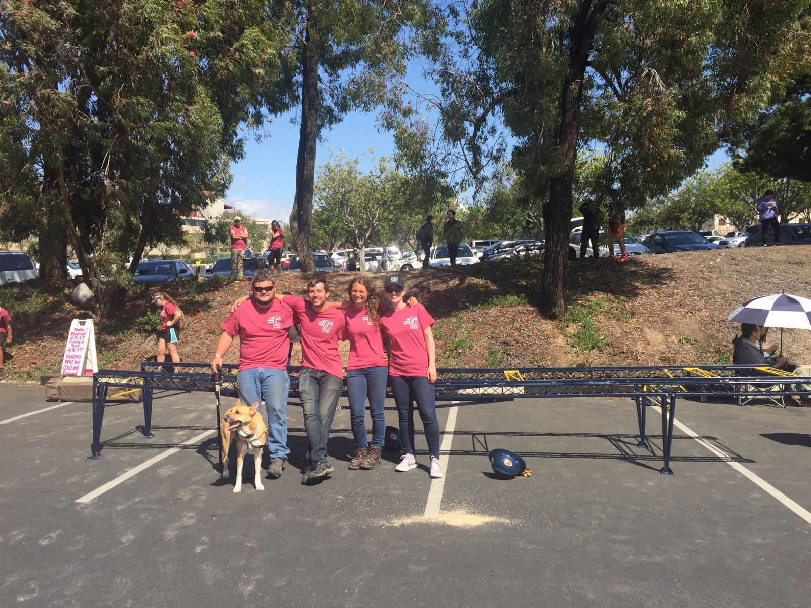
Conference Results
Construction Speed = 17:14 (4th place)
Weight = 243 lb (8th place)
Display = 3rd place
Aggregate Deflection = 4.41 inches (12th place)
Economy = $7,746,667 (6th place)
Efficiency = $16,840,000 (12th place)
Overall = $24,586,667 (9th place)
Figure 18. Bridge and Team After Loading
18 Stevens

Slide 19
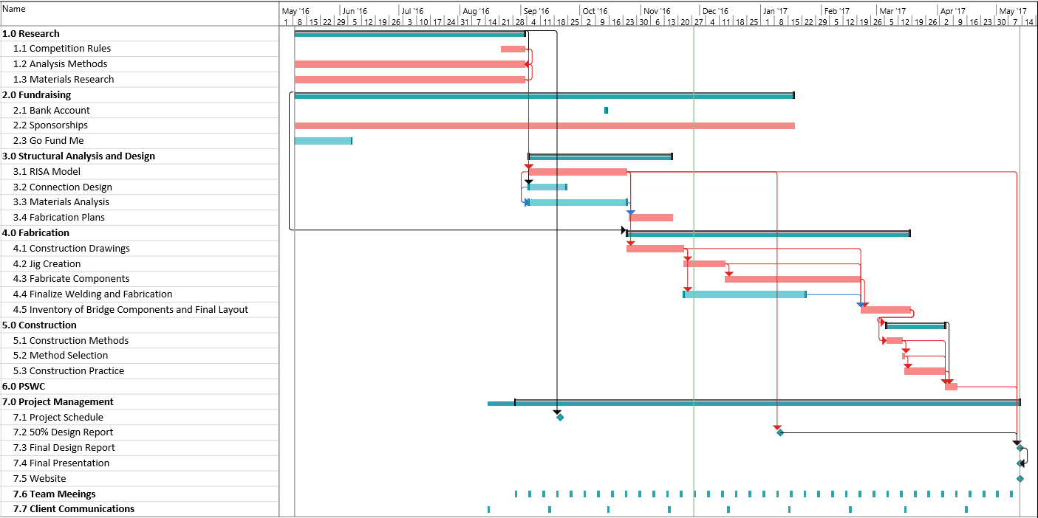
Project Schedule
Original Gantt Chart
Figure 19. Original Gantt Chart
19 Stevens

Slide 20
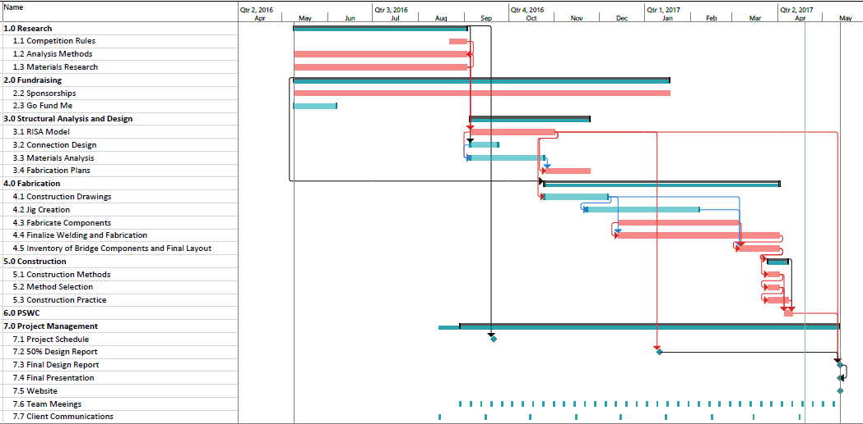
Project Schedule
Final Gantt Chart
Figure 20. Final Gantt Chart
20 Stevens

Slide 21
Summary of Project Costs
Estimated Cost vs Actual Cost
Table 4. Cost of Services
Total Cost of Services
Service | Rate | Est. Unit | Actual Unit | Est. Total Cost | Actual Total Cost
Personnel
PM | $117 per hour | 135 hours | 166 hours | $ 15,755 | $ 19,422
DSNENG | $78 per hour | 270 hours | 270 hours | $ 21,060 | $ 21,060
DRF | $54 per hour | 175 hours | 175 hours | $ 9,406 | $ 9,406
FAB | $45 per hour | 220 hours | 933 hours | $ 9,900 | $ 41,985
INT | $17 per hour | 220 hours | 220 hours | $ 3,751 | $ 3,740
Transportaiton
Lodging | 4 nights, 2 rooms | $140/night | $210/night | $ 1,120 | $ 1,680
Car Rental | 5 days | $150/day | $150/day | $ 750 | $ 750
Testing | $100 per hour | 20 hours | 20 hours | $ 2,000 | $ 2,000
Materials | Lump Sum | $4,000 | $7,000 | $ 4,000 | $ 7,000
Total |  |  |  | $ 67,742 | $ 107,043
$39,301 over estimated budget
1020 estimated hours
1734 actual hours
21 Stevens

Slide 22
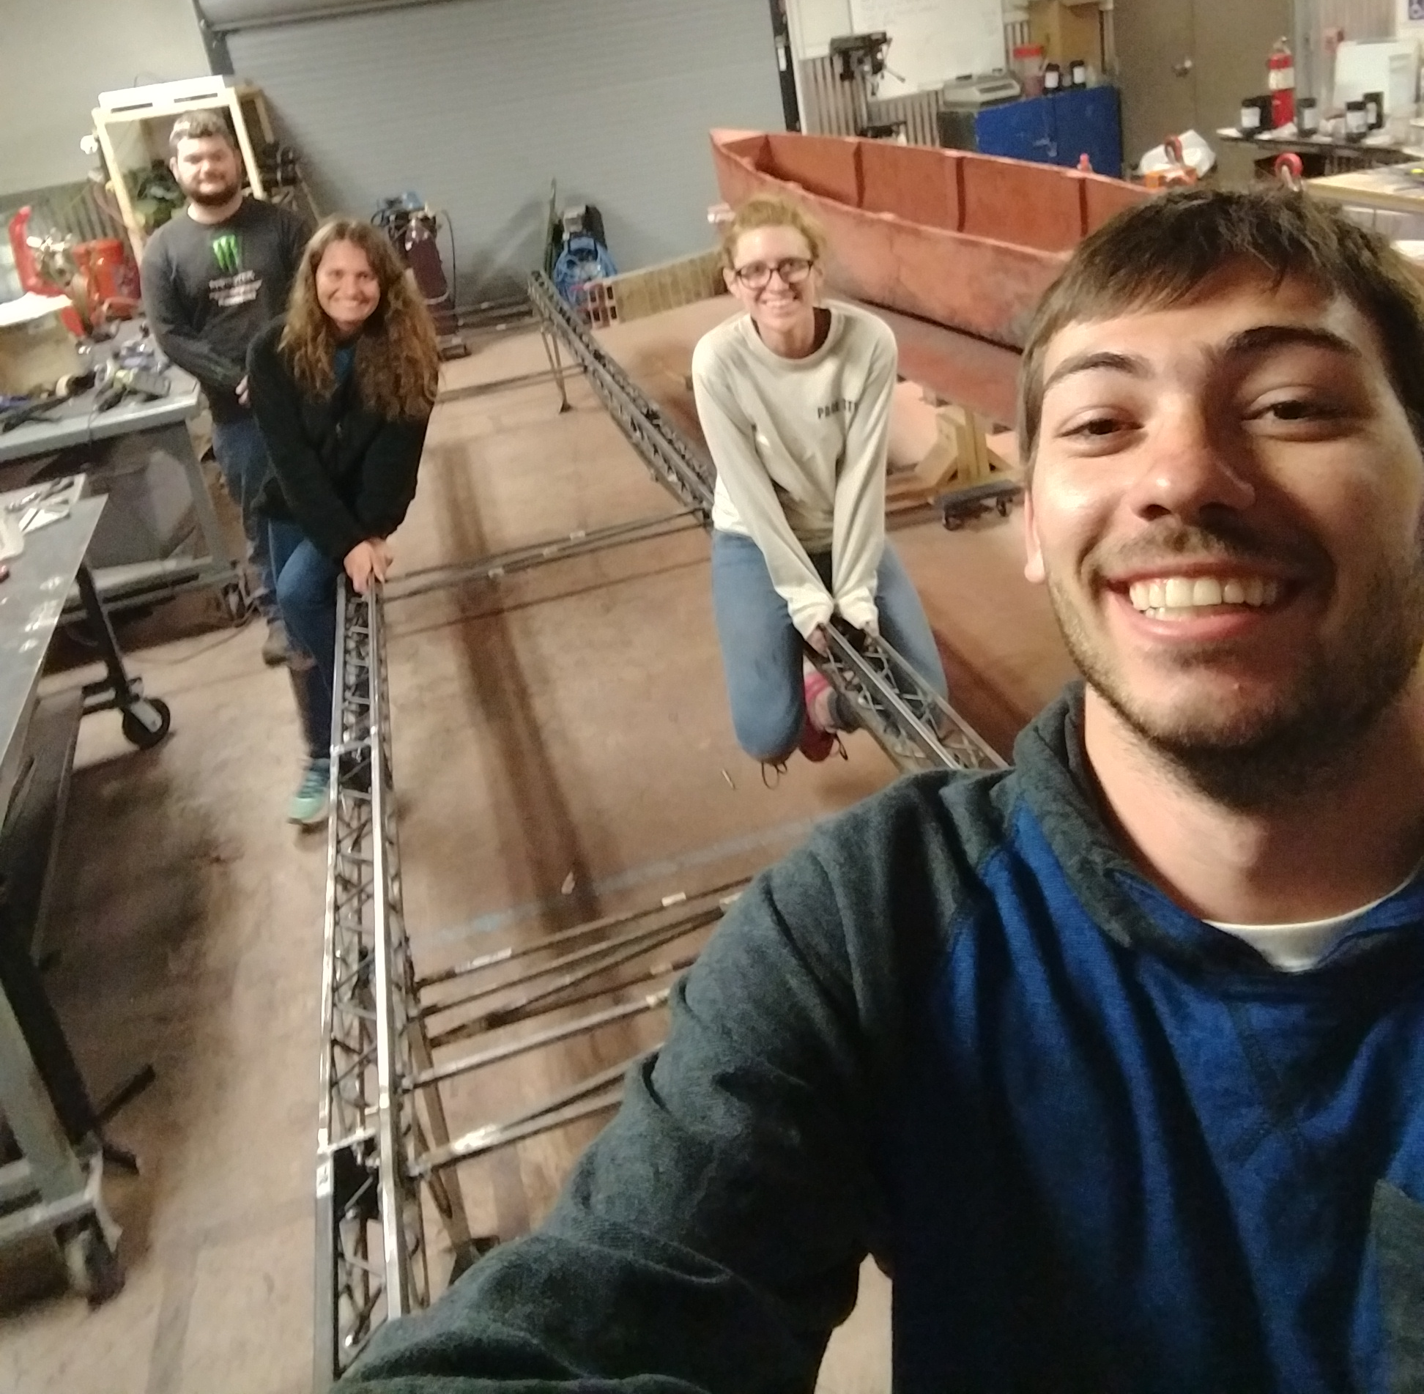
Impacts / Takeaways
Impacts for future
  Communication
  Teamwork
  Project Management
Takeaways
  Equipment and Space Limitiations
    TIG welder
    Welding indoors
  Importance of connections
  Pre-testing the bridge
    Find areas of concern
Figure 21. Bridge Selfie
22 Stevens

Slide 23
References
[1] "ASCE - AISC Student Steel Bridge Competitions", Aisc.org, 2016. [Online]. Available: http://www.aisc.org/content.aspx?id=780.
[2] Excel. Microsoft, 2017.
[3] RISA-3D. RISA Technologies, 2017.
[4] Solidworks. Dassault Systemes, 2017.
[5] Project. Microsoft, 2017.
[6] American Institute of Steel Construction. Steel Construction Manual, 14th Ed., Fourth Printing

Slide 24


Supplemental Information – Scoring Equations
Structural Efficiency, Cs [1]
For a bridge that weighs 303 pounds or less:
$$=Total weight \left(pounds\right)x10,000\left(\frac{\$}{pound}\right)Aggregate deflection \left(inches\right)x1,000,000\left(\frac{\$}{inch}\right)+Load test penalties$$
For a bridge that weighs more than 303 pounds:
$$={\left[Total weight \left(pounds\right)\right]}^{2}x33\left(\frac{\$}{pound^{2}}\right)Aggregate deflection \left(inches\right)x1,000,000\left(\frac{\$}{inch}\right)+Load test penalties$$
Cs
Cs
Construction Economy, Cc [1]
Cc
$$=Total time \left(minutes\right) x number of builders\left(persons\right) x 50,000\left(\frac{\$}{person minute}\right)+\$30,000 for each temporaty pier that is staged for construction+load test penalties(\$)$$
Overall Score = Structural Efficiency + Construction Economy

